Slide 1

AI POWERED SUPPLY CHAIN RESILIENCE INDEX(SCRI)
Presented by: Chain Vision
Team Members:
Sai Kamal Makthala
Likhitha Neerati
Sindhu Mukkara
Lalitha Rani Palakaluri

Slide 2
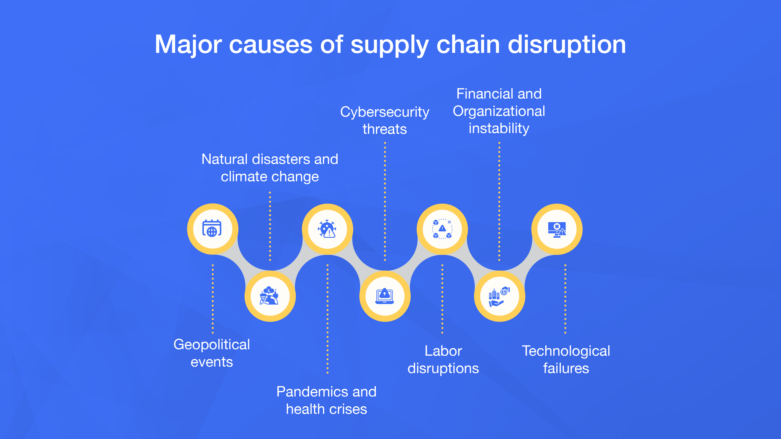
Why Supply Chains Need Resilience
Modern supply chains are increasingly complex and globally distributed.
Disruptions due to weather, pandemics, and geopolitical issues can cripple operations.
Companies lack tools for real-time, data-driven risk assessments.
Billions are lost annually due to delays, lost shipments, and poor planning.

Slide 3
Our Goal
To build a real-time AI system to assess and predict delivery risk.
Combine customer, retailer, and logistics data with live weather inputs.
Generate text-based suggestions for customers on orders and getting optimal routes for logistics and retailers for faster delivery.
Enable proactive decision-making and improve service continuity.

Slide 4
How SCRI Works
Input Interface (via Streamlit Web App):
Users interact through a simple, intuitive web UI with three modules:
Customer: Enter city and product to check delivery risk.
Retailer: Assess shipment route from warehouse to customer.
Logistics: Optimal routing at the warehouse level based on destination, product, and shipping mode.

Slide 5
How SCRI Works COTD..
Real-Time Data Integration:
Weather API (OpenWeather): Fetches live weather details:
Temperature
Wind Speed
Rainfall
Geographic coordinates (lat/lon)
Routing API (OpenRouteService): Calculates driving routes between customer and warehouse locations.
Visualized using Folium Maps in the app.

Slide 6
Customer Risk Prediction (LSTM Model)
Objective: Predict if a customer delivery is at high risk due to local weather conditions.
Input Features:
Temperature
Wind Speed
Rain Volume
Model Type: LSTM (Long Short-Term Memory)
Why LSTM? Weather is time-series data, and LSTM models capture patterns across time. Here, we're simulating a sequence of 7 past weather readings (even if repeated).
Output: A binary risk score (between 0 and 1) — higher means more delivery risk.
Use Case: If a customer in San Francisco places an order during a storm, the model can flag this as high risk, prompting proactive steps like delay notices.

Slide 7
Retailer Delivery Risk (MLP Model)
Objective: Predict the delivery risk from warehouse to customer.
Input Features:
Encoded values of:
Shipping Method (Standard, Express, Same-Day)
Payment Method (Credit Card, PayPal, etc.)
Order Status (Confirmed, Shipped, etc.)
Warehouse City
Current weather conditions at warehouse
Model Type: MLP (Multi-Layer Perceptron)
A dense neural network, ideal for static, tabular data.
Output: Risk score (0–1)

Slide 8
Logistics Warehouse Risk (MLP Model)
Objective: Predict risk in logistics operations — from warehouse to destination city.
Input Features:
Encoded values of:
Product Name
Destination City
Shipping Mode (Air, Truck, Rail, Ship)
Weather conditions at the destination
Model Type: MLP
Output: Risk score (0–1)

Slide 9
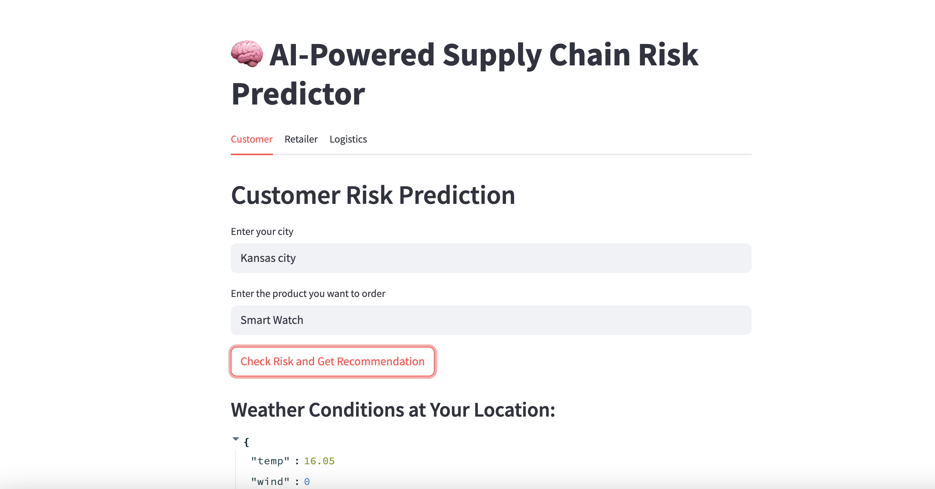
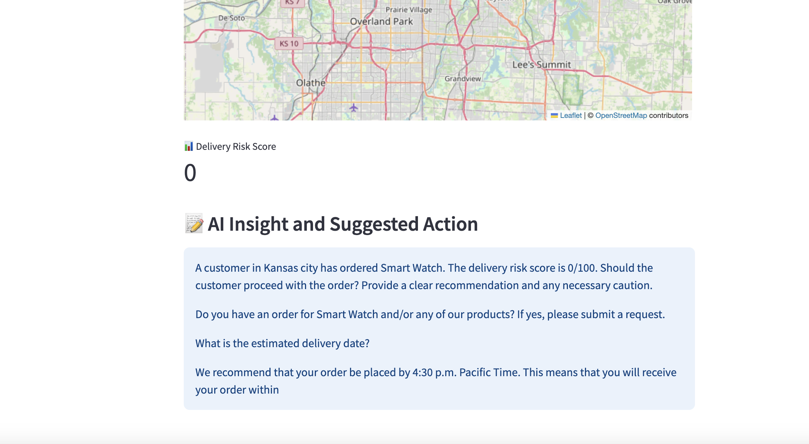
Outputs
Customer outputs:

Slide 10
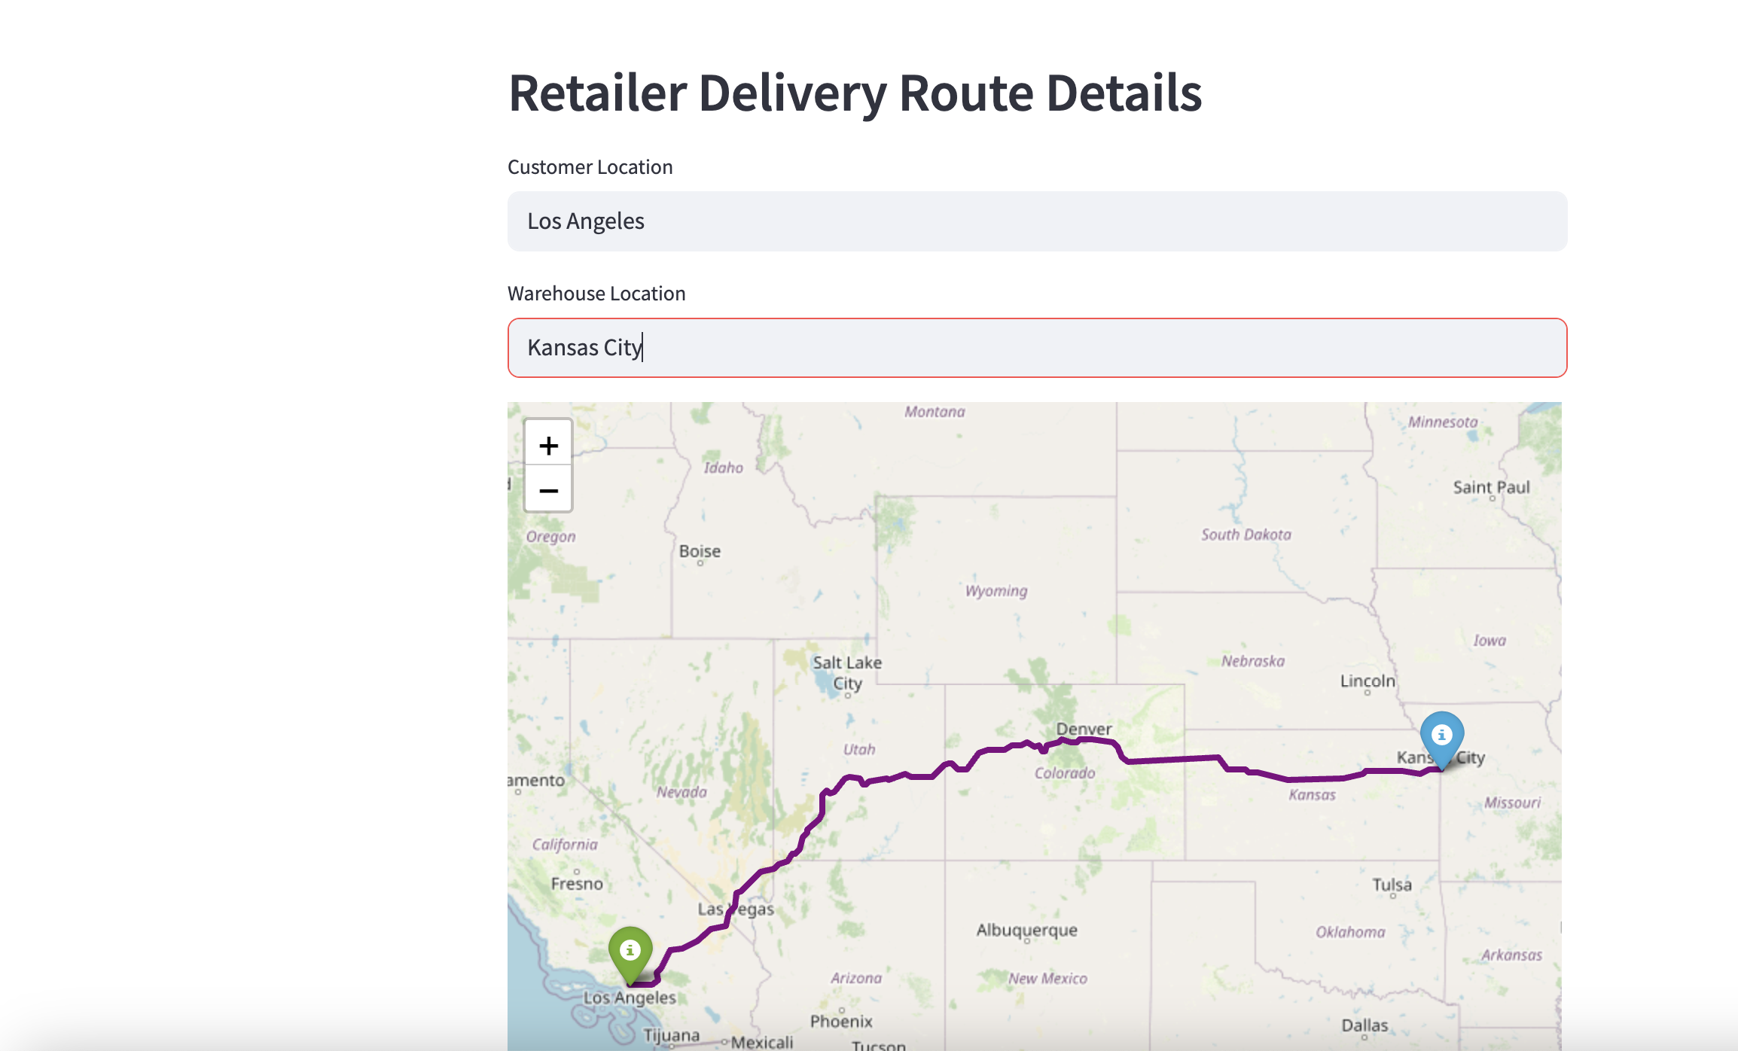
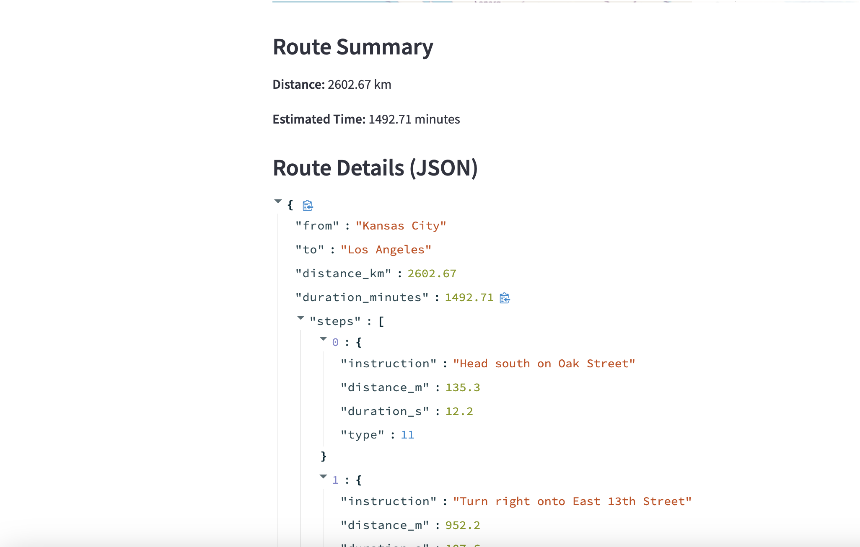
Retailer Outputs:

Slide 11
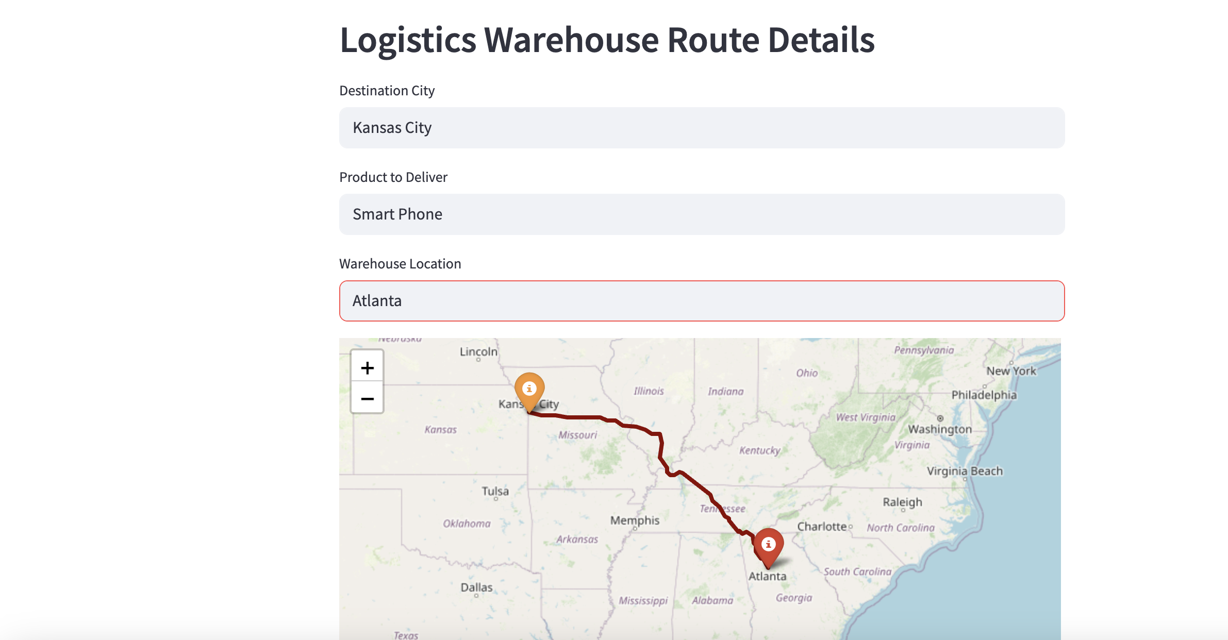
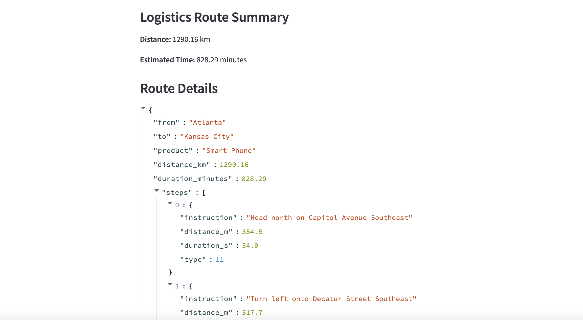
Logistics Outputs:

Slide 12
Conclusion
Our SCRI system combines AI models, real-time weather data, and supply chain variables to proactively assess delivery risks.
Bridged three critical supply chain components, Customer, Retailer, and Logistics with dedicated machine learning models.
Using ORS helped getting optimal routes to deliver the products with precise routing information for retailers and logistics.

Slide 13
Thank You !!

